Slide 1

www.cybage.com
Landing Page
Copyright © 2011. Cybage Software Pvt. Ltd. All Rights Reserved. Cybage Confidential.

Slide 2
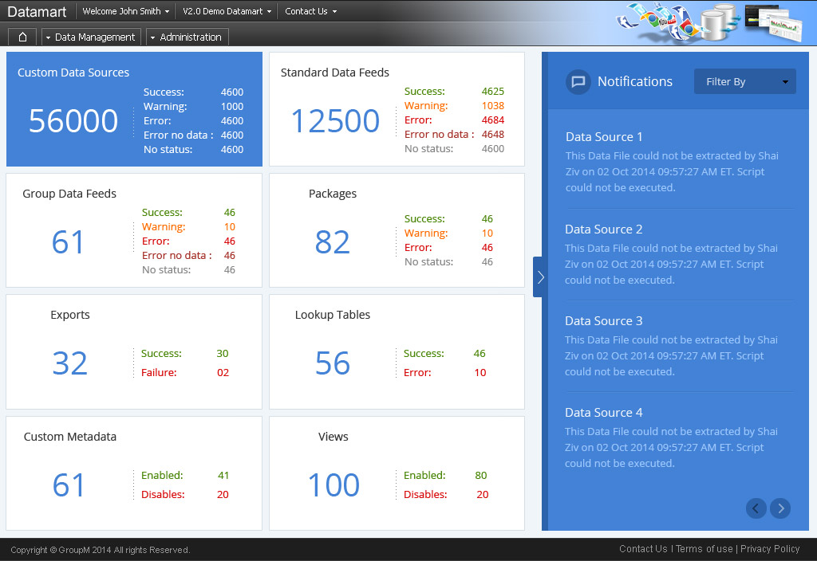
Landing Page
Copyright © 2011. Cybage Software Pvt. Ltd. All Rights Reserved. Cybage Confidential.

Slide 3
www.cybage.com
Custom Data Source > Acquire
Copyright © 2011. Cybage Software Pvt. Ltd. All Rights Reserved. Cybage Confidential.

Slide 4
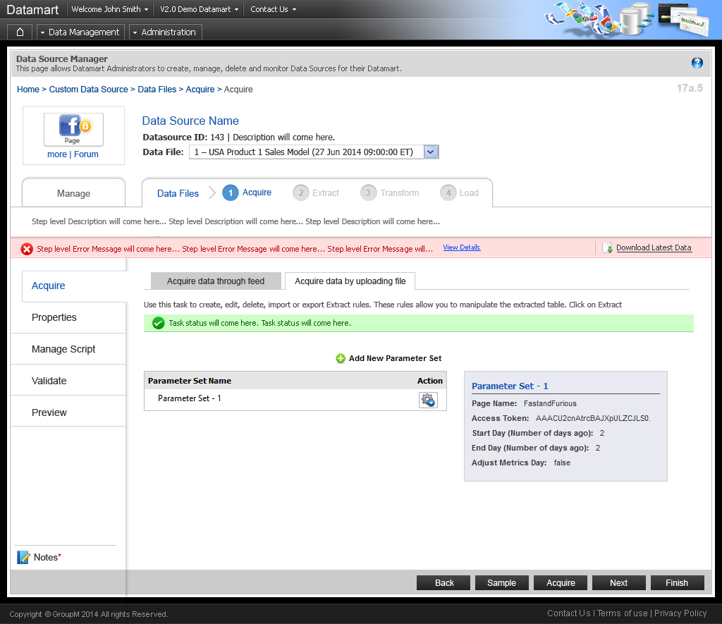
Landing Page

Slide 5
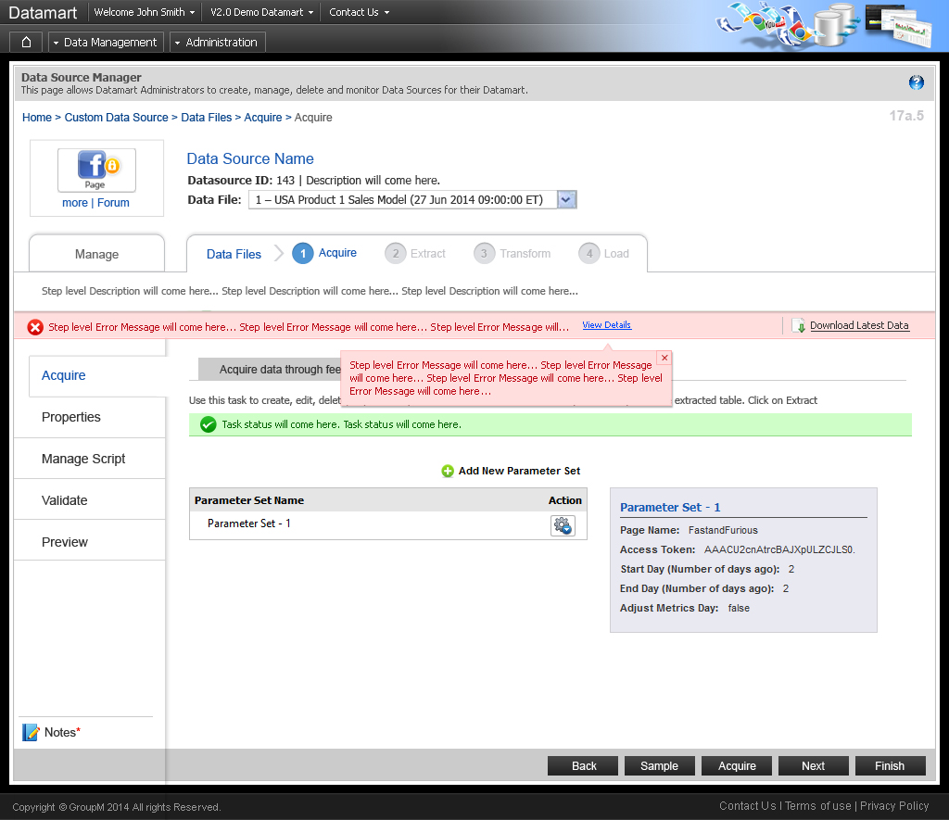
Landing Page

Slide 6
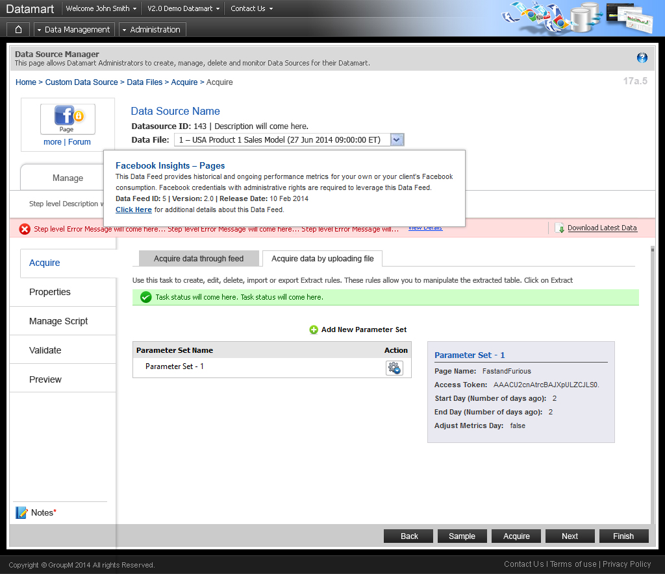
Landing Page

Slide 7
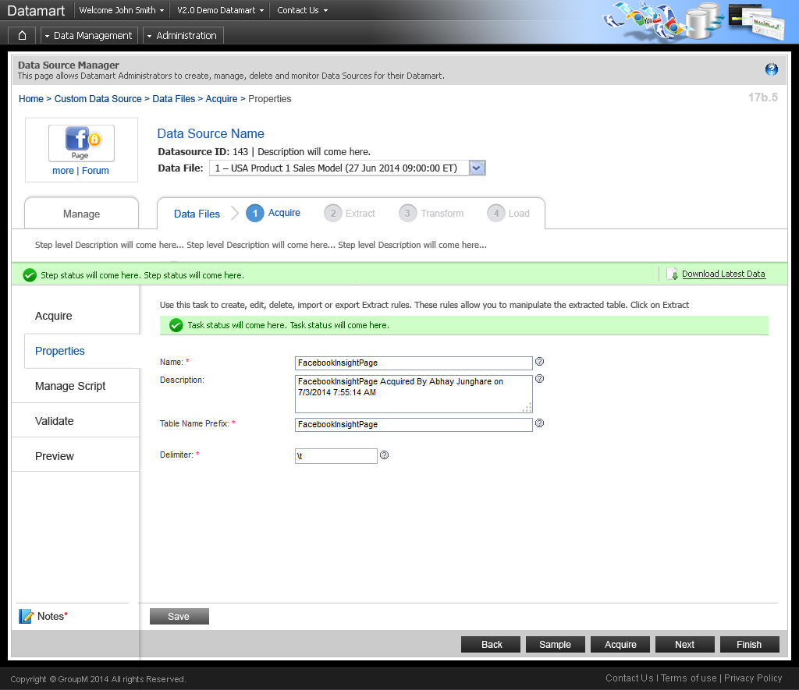
Landing Page

Slide 8
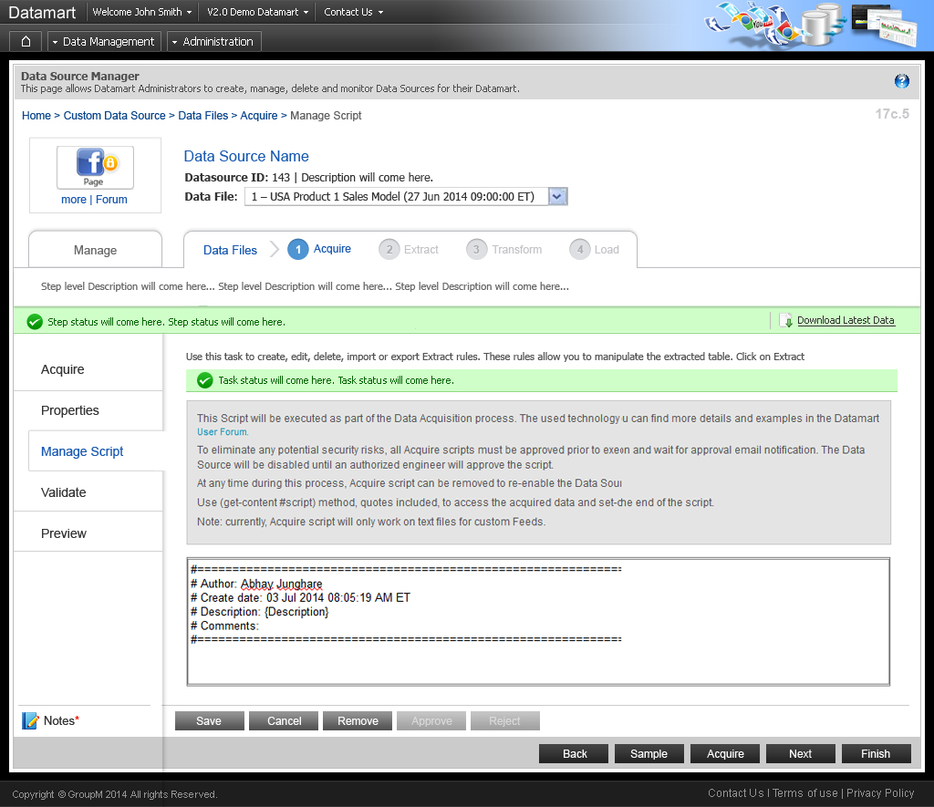
Landing Page

Slide 9
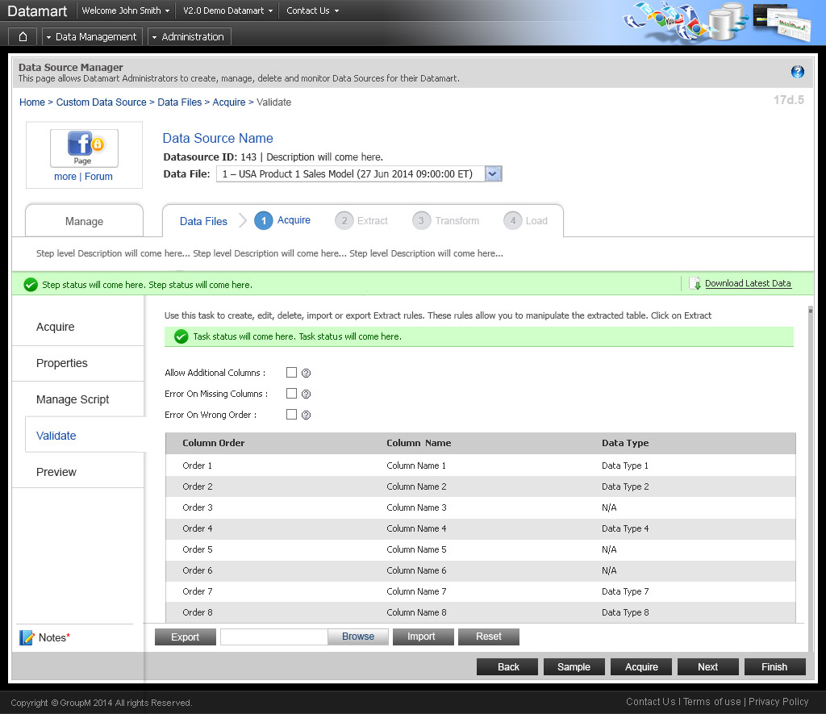
Landing Page

Slide 10
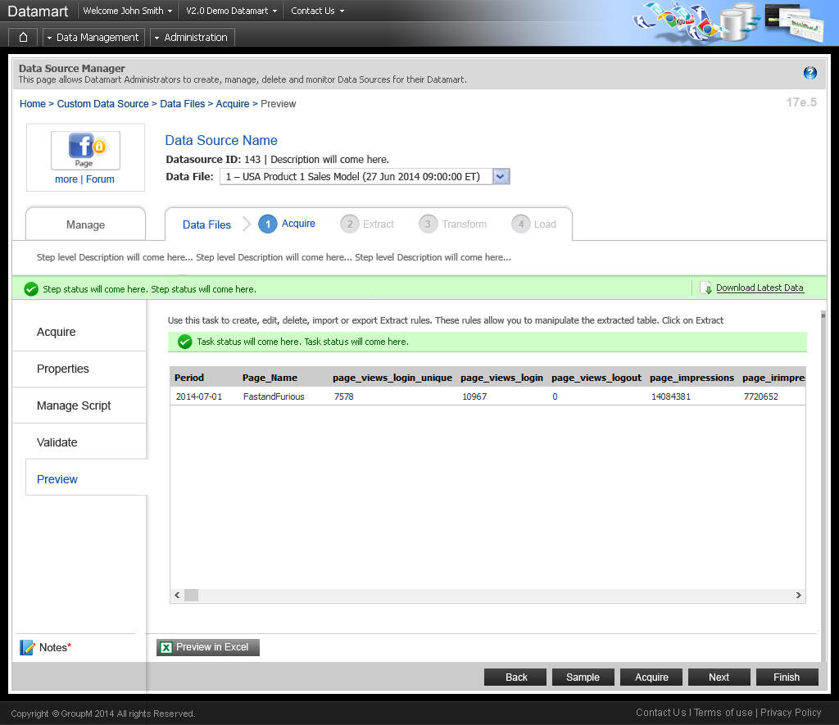
Landing Page

Slide 11
www.cybage.com
Custom Data Source > Extract
Copyright © 2011. Cybage Software Pvt. Ltd. All Rights Reserved. Cybage Confidential.

Slide 12
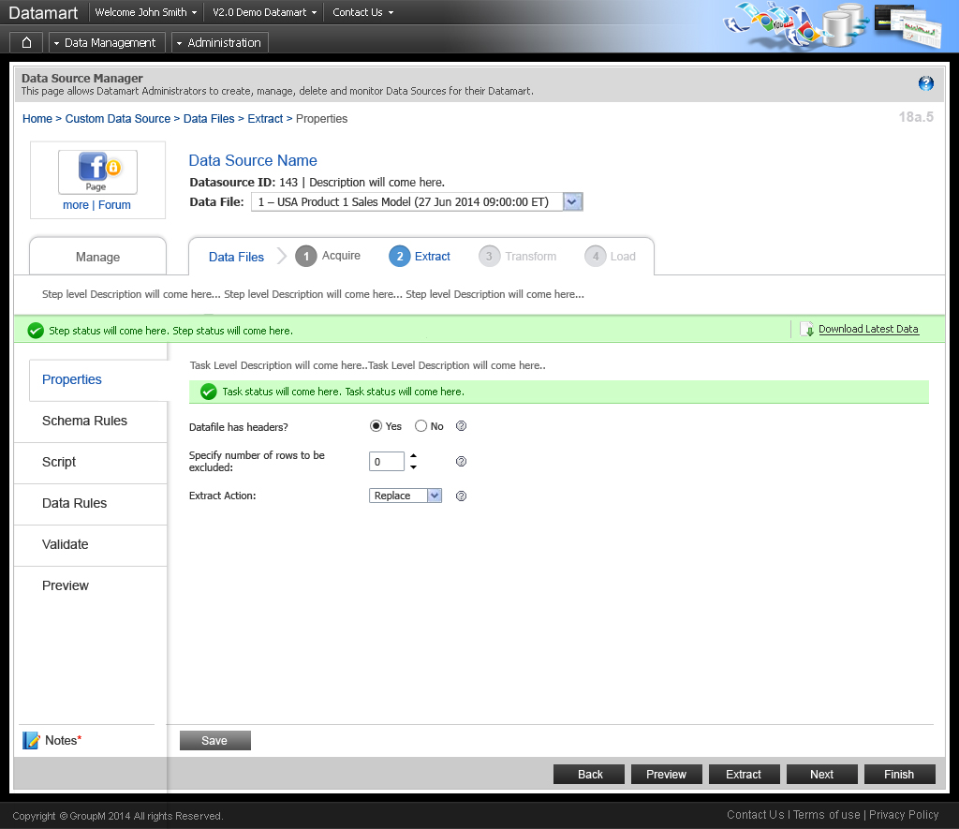
Landing Page

Slide 13
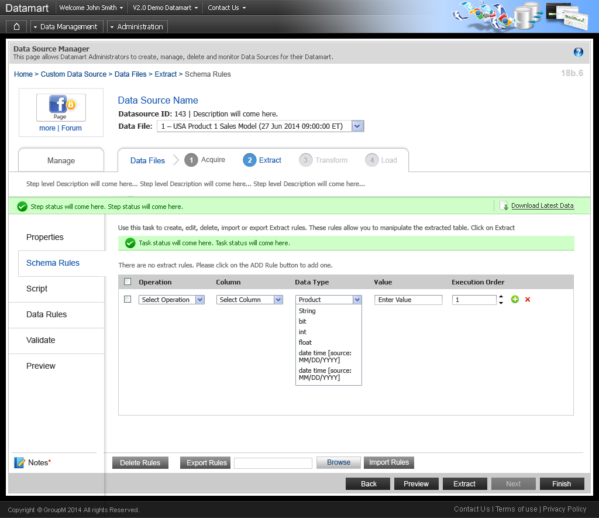
Landing Page

Slide 14
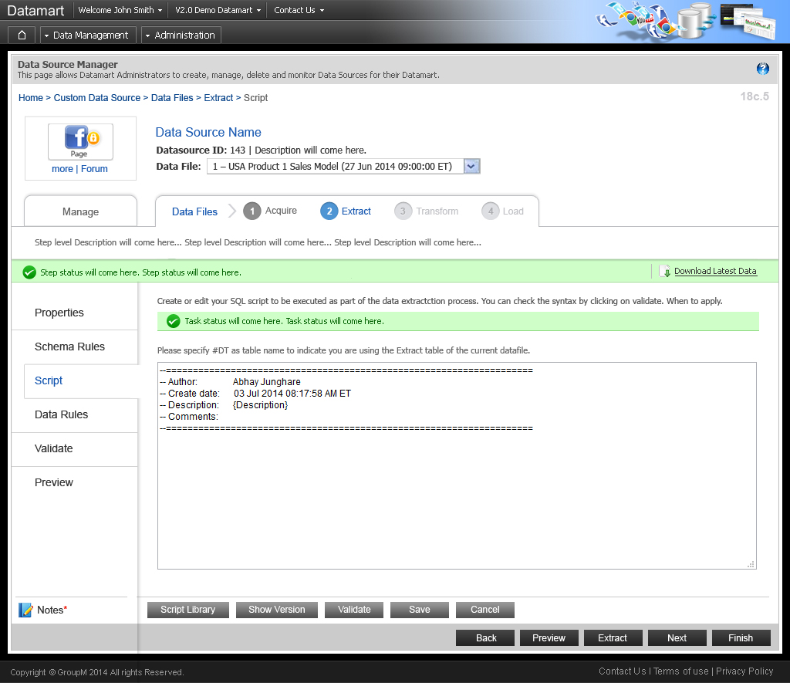
Landing Page

Slide 15
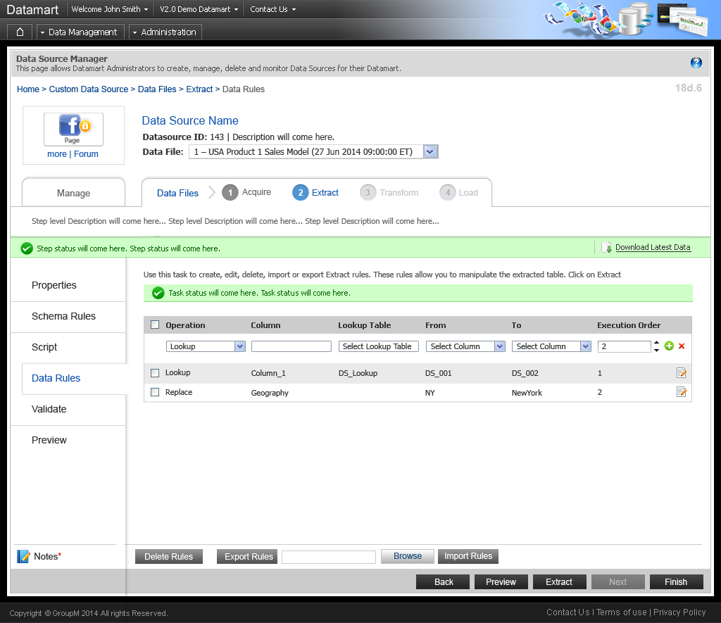
Landing Page

Slide 16

Landing Page

Slide 17
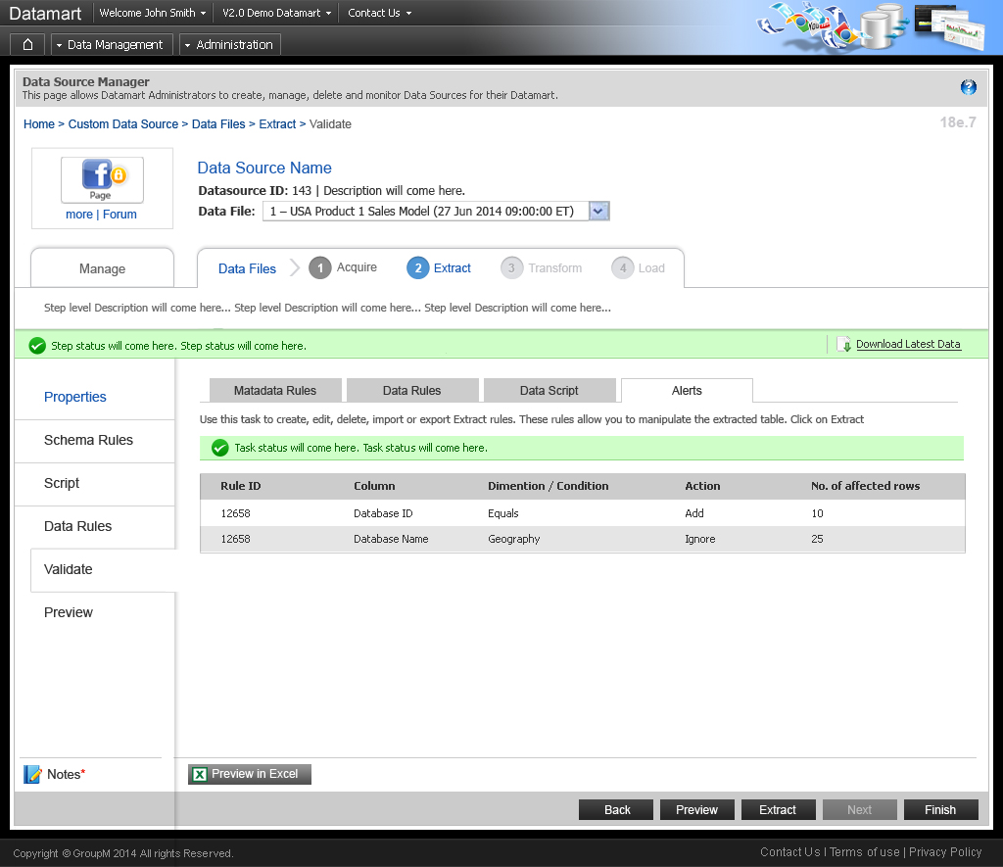
Landing Page

Slide 18
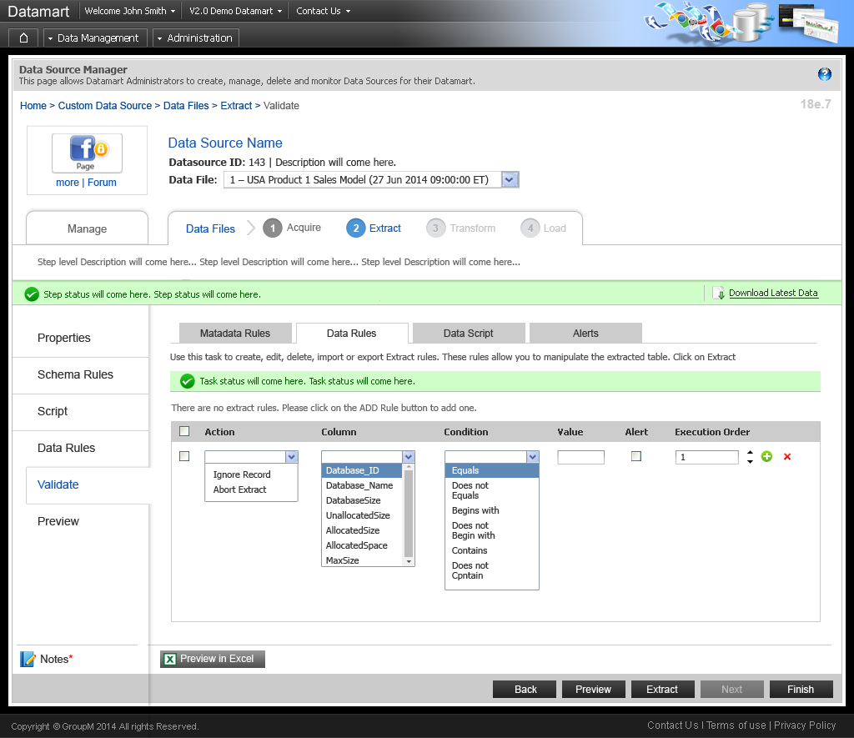
Landing Page

Slide 19
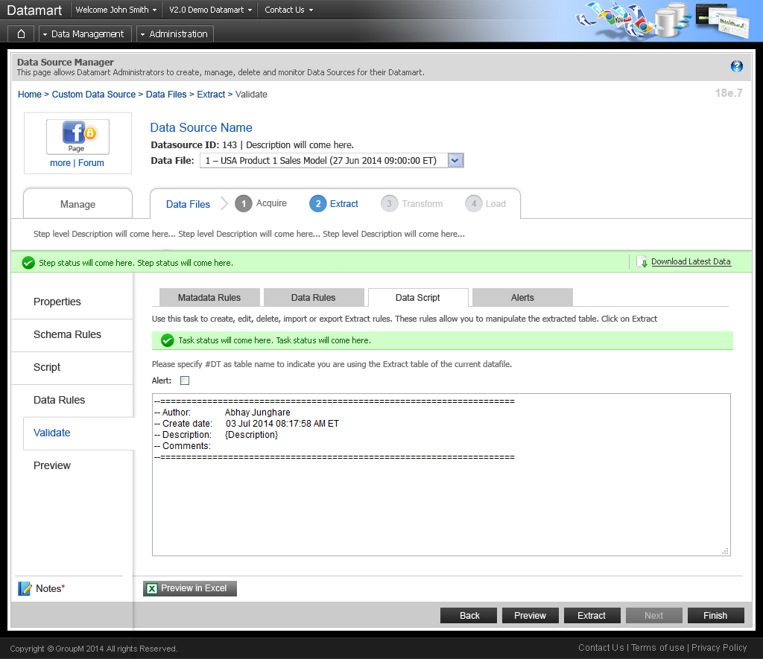
Landing Page

Slide 20
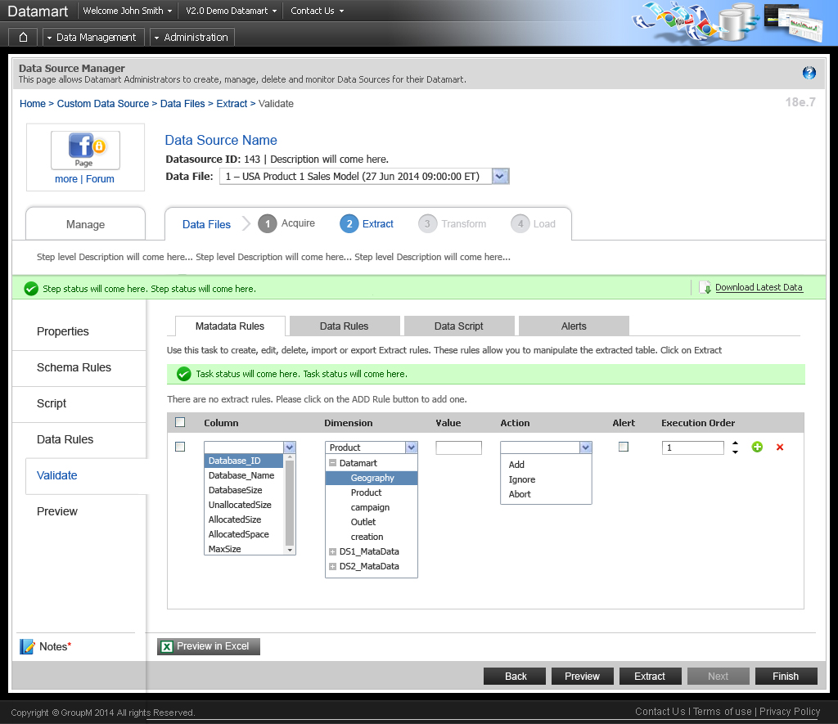
Landing Page

Slide 21
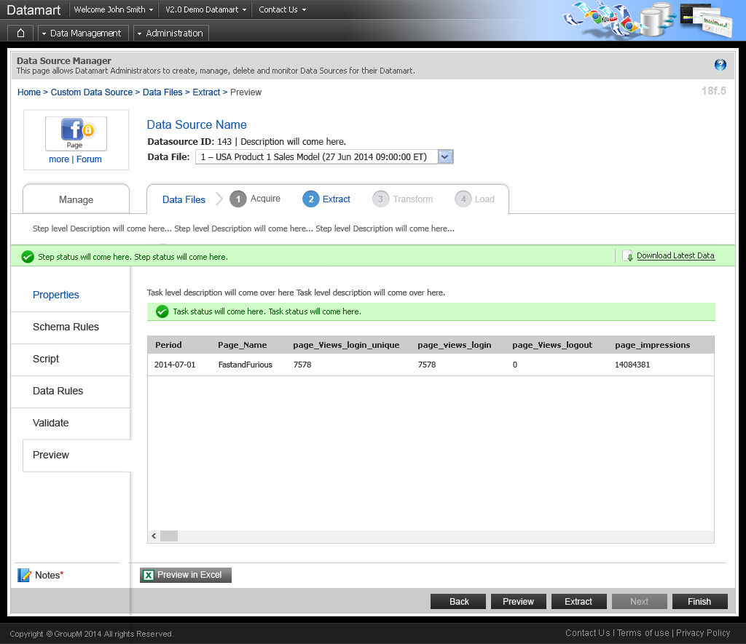
Landing Page

Slide 22
www.cybage.com
Custom Data Source > Transform
Copyright © 2011. Cybage Software Pvt. Ltd. All Rights Reserved. Cybage Confidential.

Slide 23
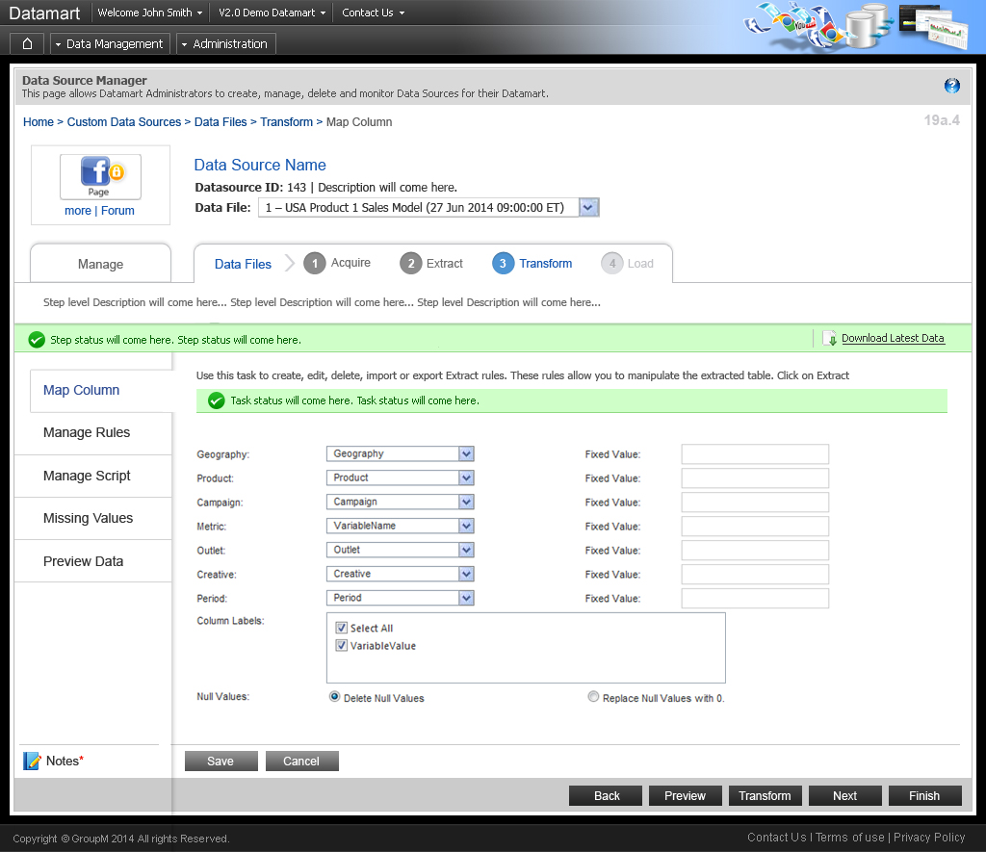
Landing Page

Slide 24
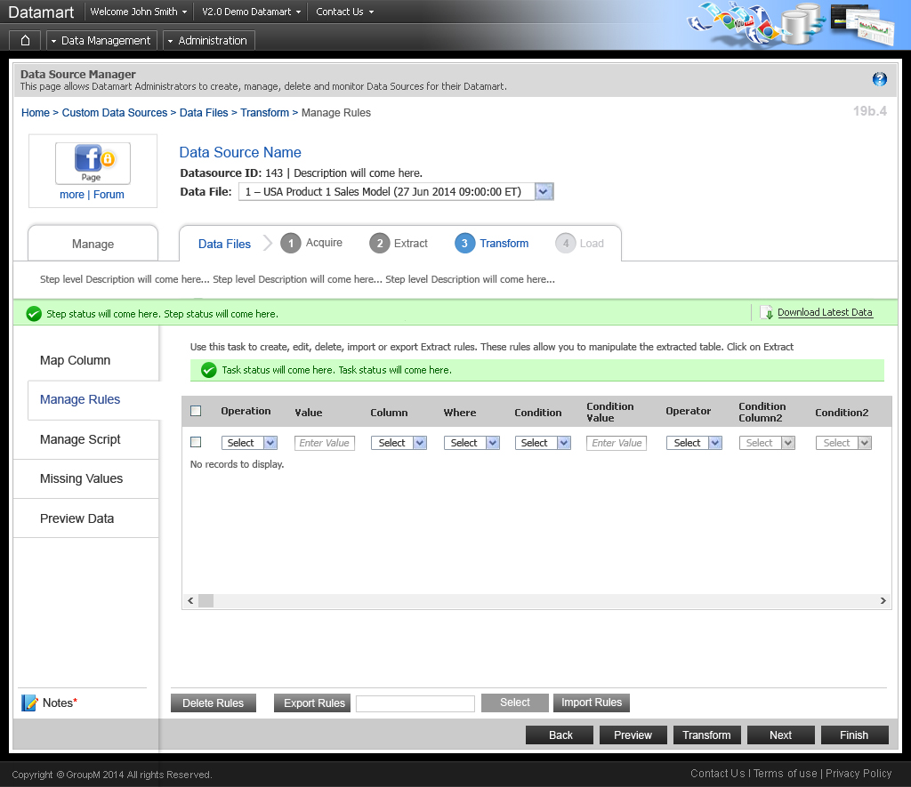
Landing Page

Slide 25
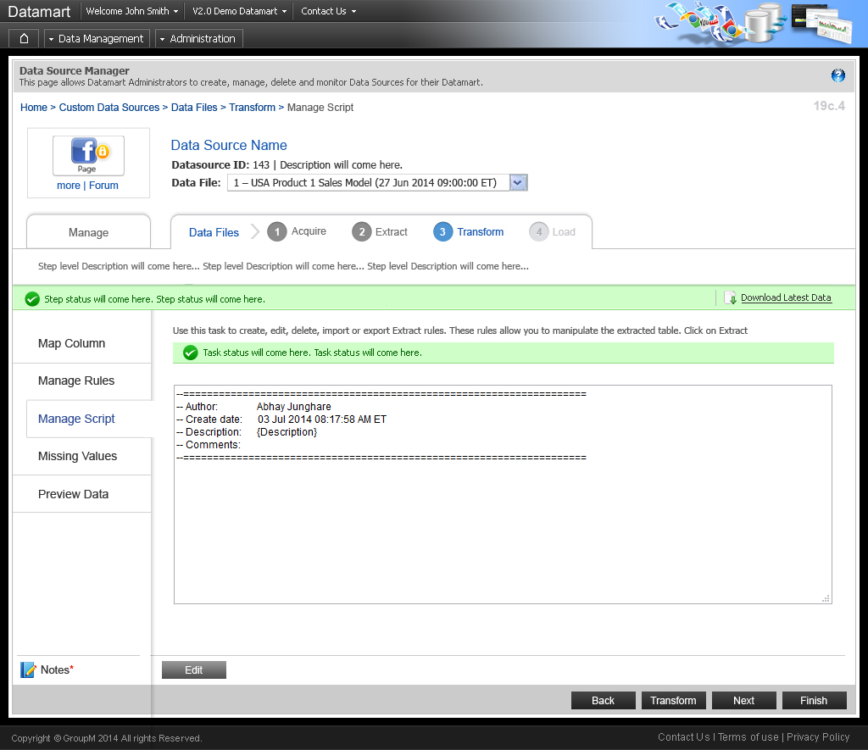
Landing Page

Slide 26
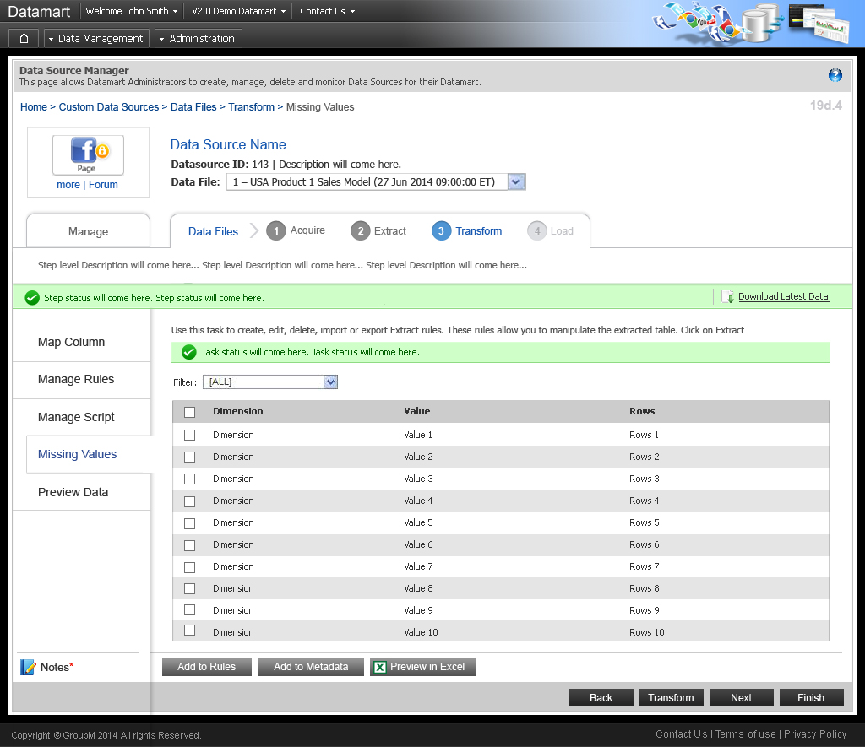
Landing Page

Slide 27
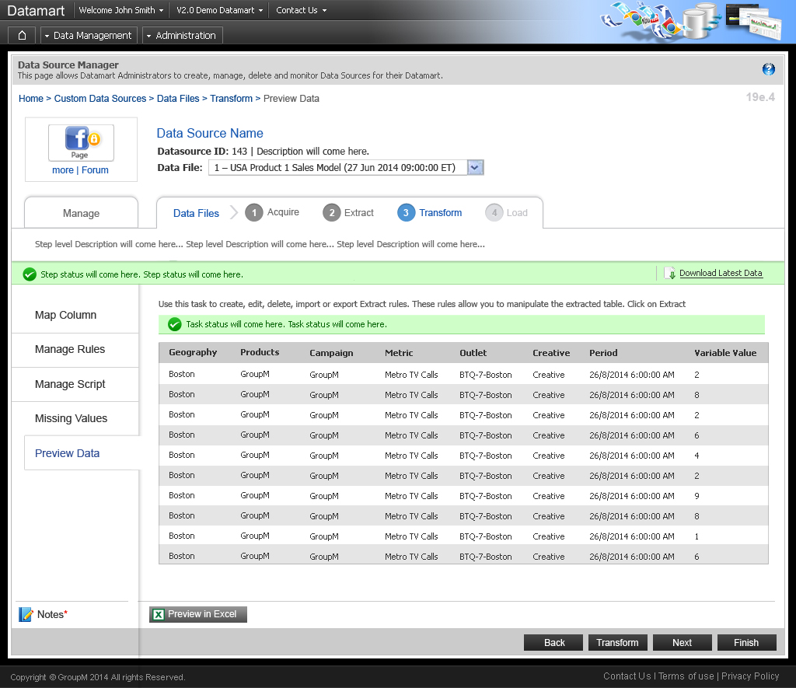
Landing Page

Slide 28
www.cybage.com
Custom Data Source > Load
Copyright © 2011. Cybage Software Pvt. Ltd. All Rights Reserved. Cybage Confidential.

Slide 29
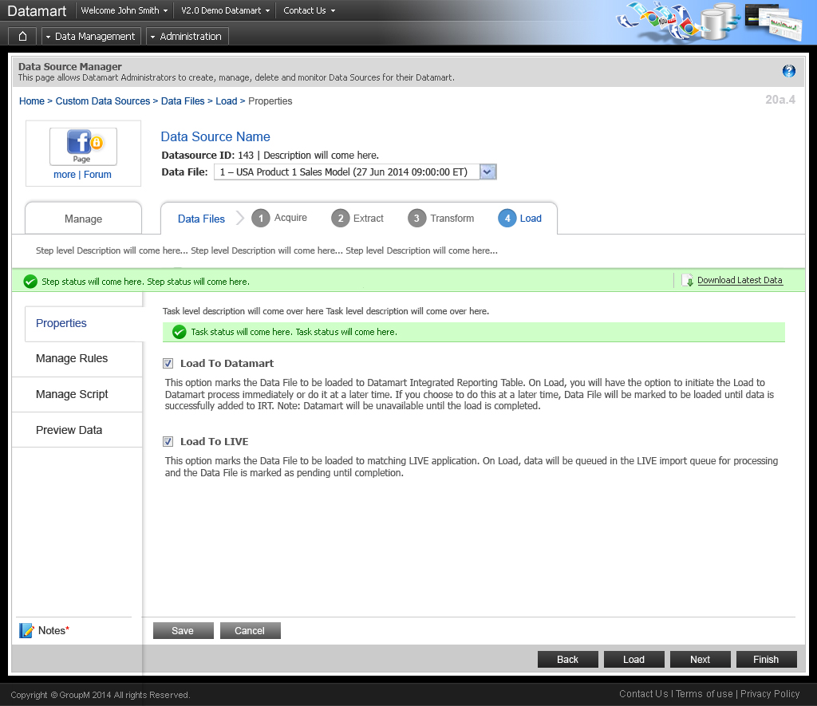
Landing Page

Slide 30
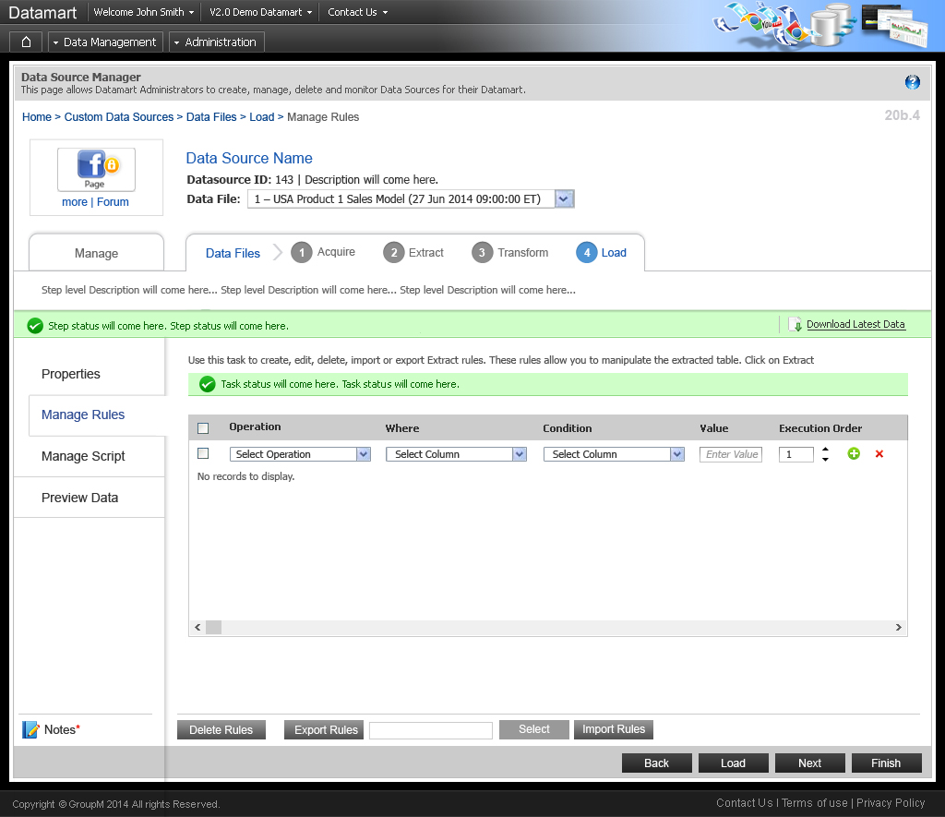
Landing Page

Slide 31
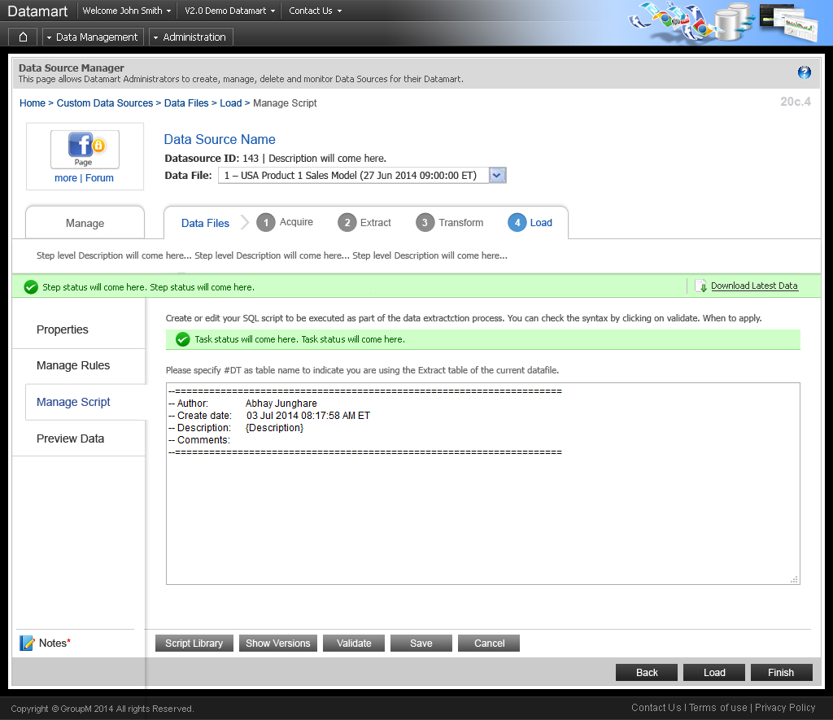
Landing Page

Slide 32
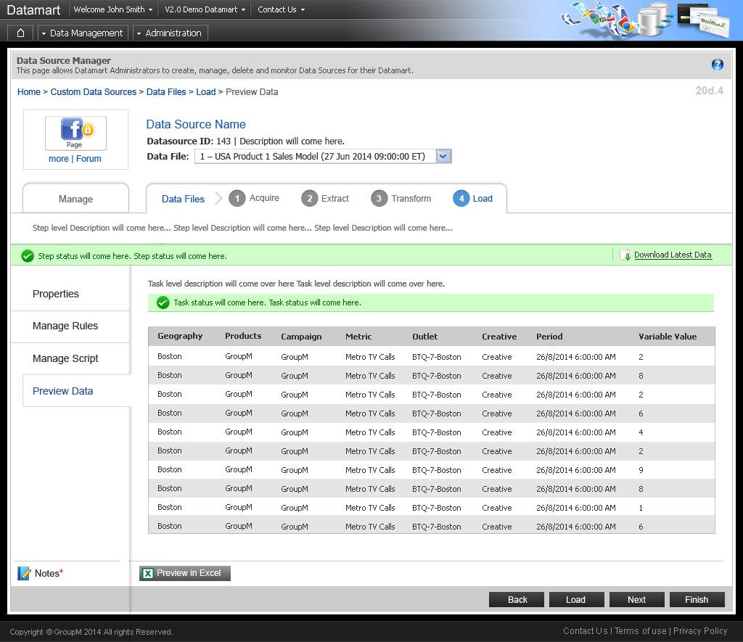
Landing Page

Slide 33
www.cybage.com
Custom Package > Create Custom Package
Copyright © 2011. Cybage Software Pvt. Ltd. All Rights Reserved. Cybage Confidential.

Slide 34
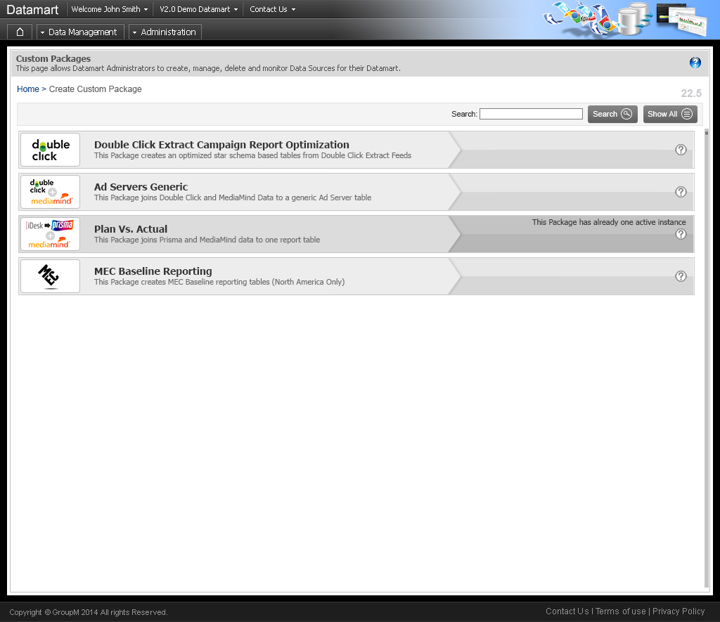
Landing Page

Slide 35
www.cybage.com
Custom Package > Package Manager
Copyright © 2011. Cybage Software Pvt. Ltd. All Rights Reserved. Cybage Confidential.

Slide 36
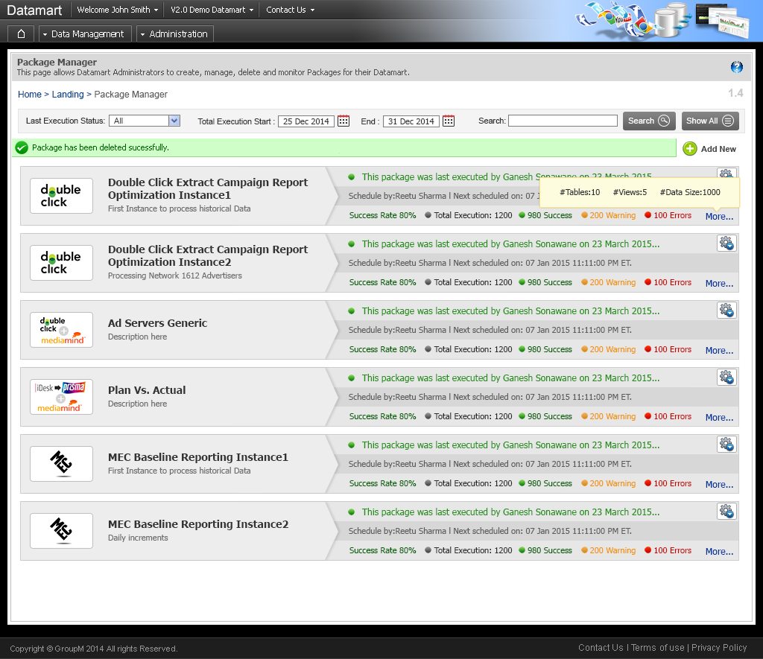
Landing Page

Slide 37
www.cybage.com
Custom Package > Manage Package
Copyright © 2011. Cybage Software Pvt. Ltd. All Rights Reserved. Cybage Confidential.

Slide 38
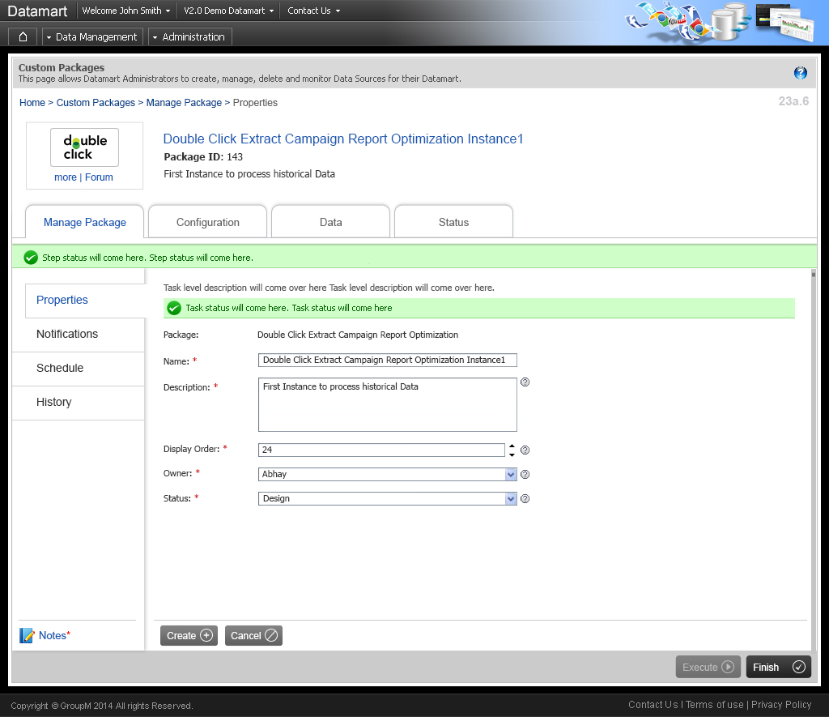
Landing Page

Slide 39
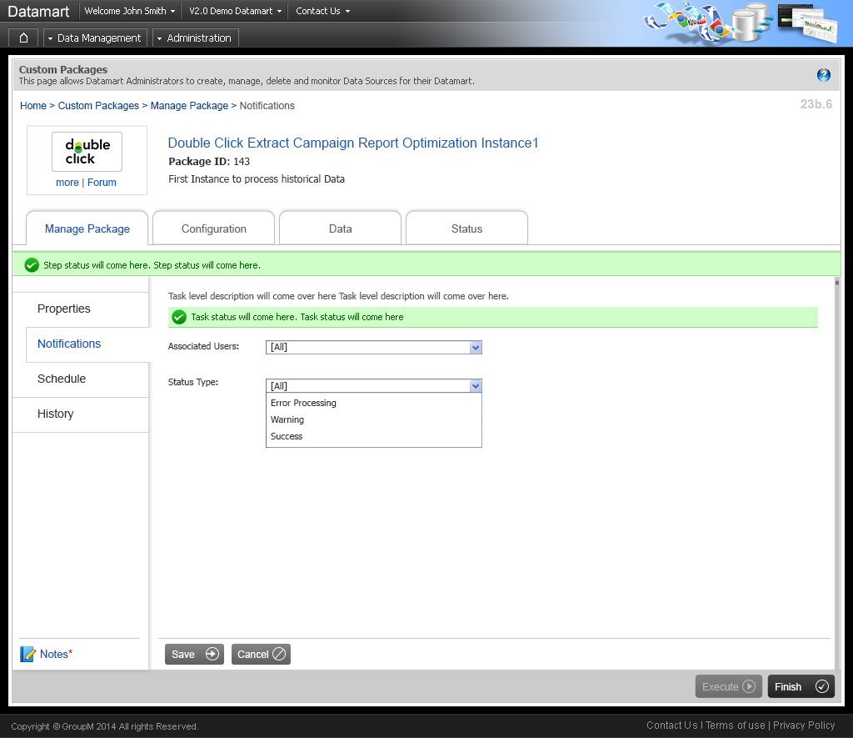
Landing Page

Slide 40
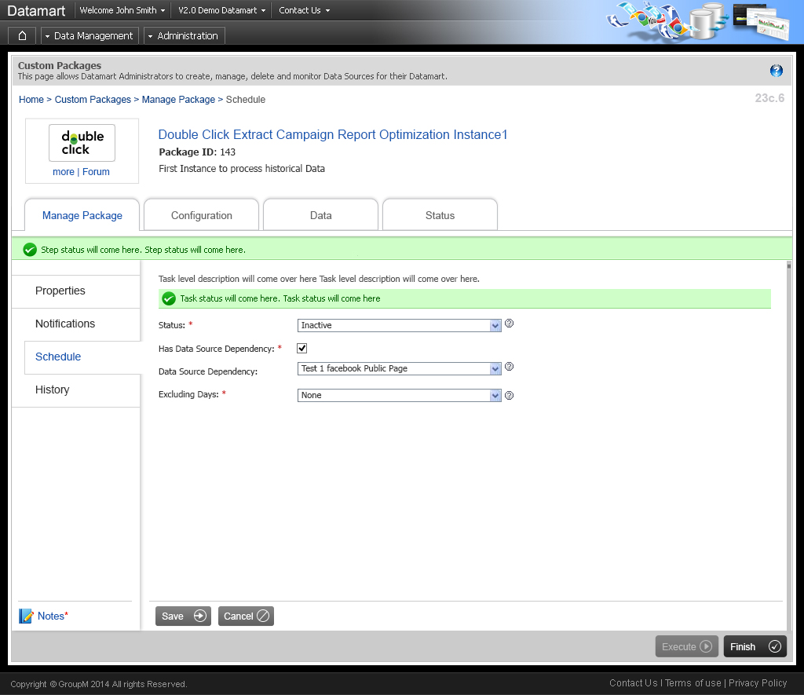
Landing Page

Slide 41
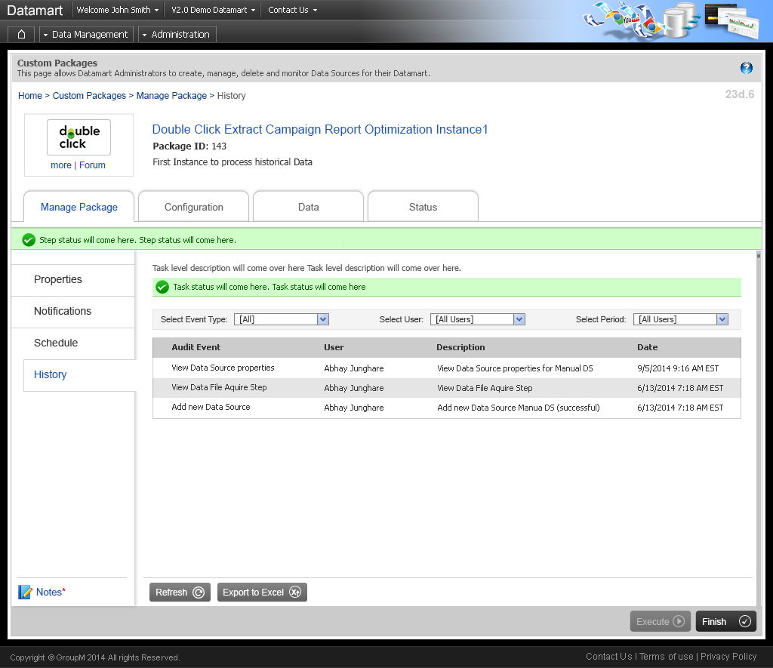
Landing Page

Slide 42
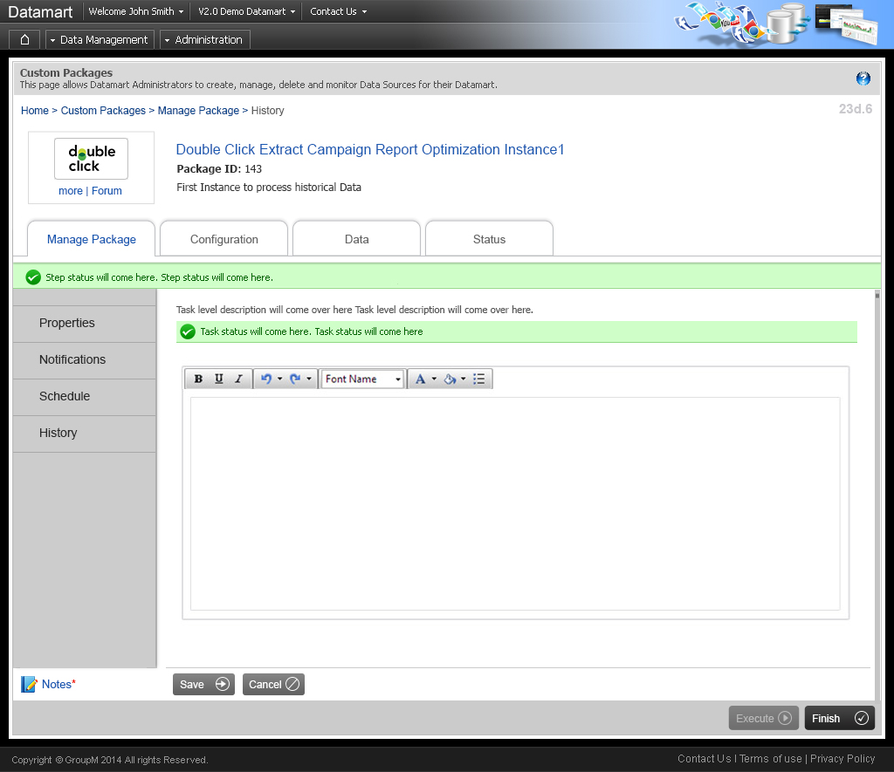
Landing Page

Slide 43
www.cybage.com
Custom Package > Configuration
Copyright © 2011. Cybage Software Pvt. Ltd. All Rights Reserved. Cybage Confidential.

Slide 44
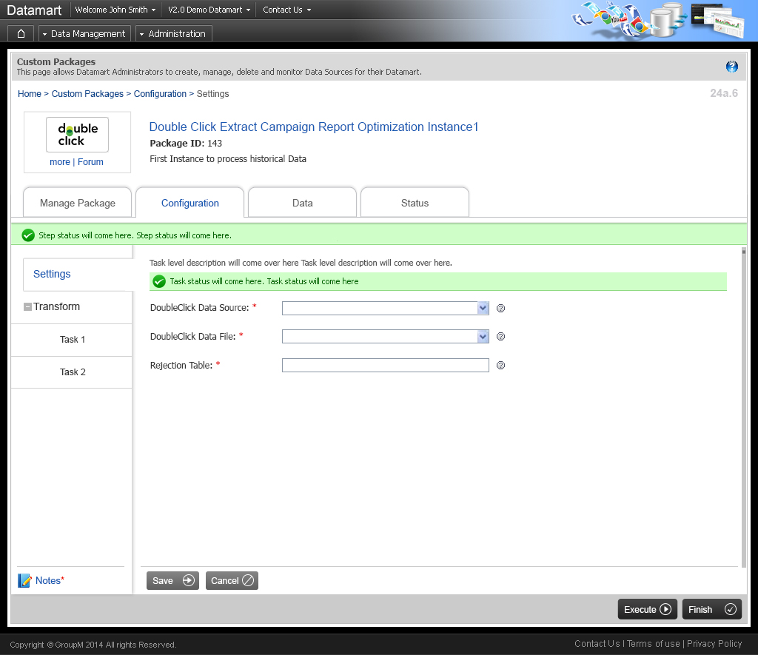
Landing Page

Slide 45

Landing Page

Slide 46
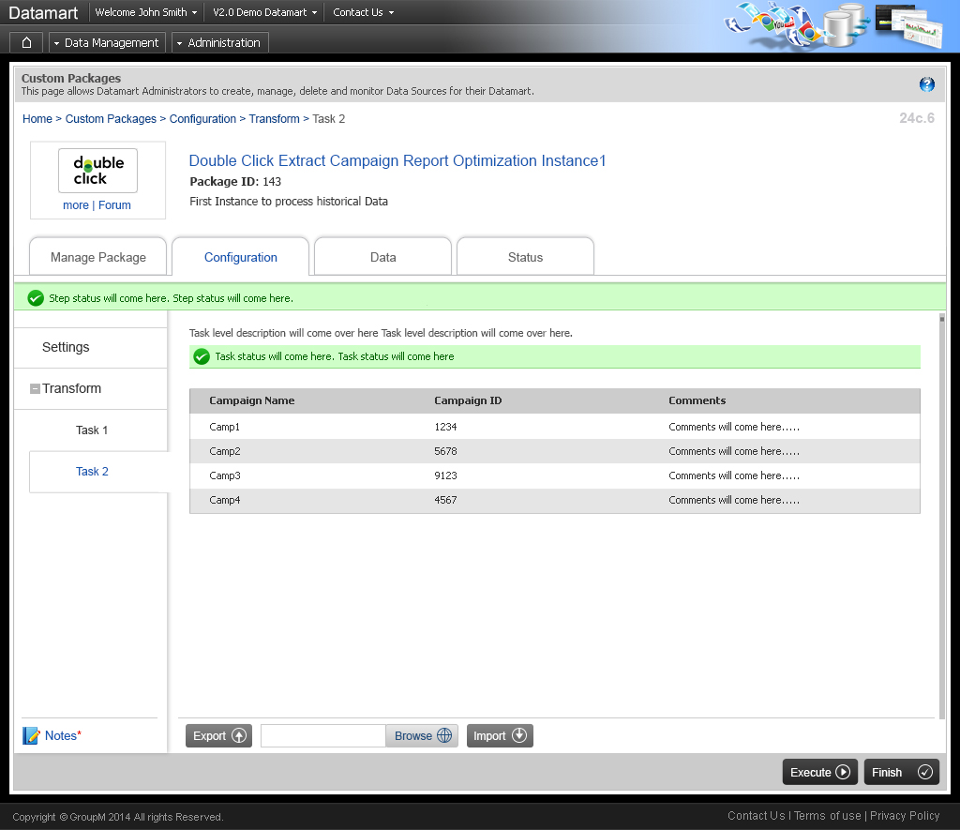
Landing Page

Slide 47
www.cybage.com
Custom Package > Data
Copyright © 2011. Cybage Software Pvt. Ltd. All Rights Reserved. Cybage Confidential.

Slide 48
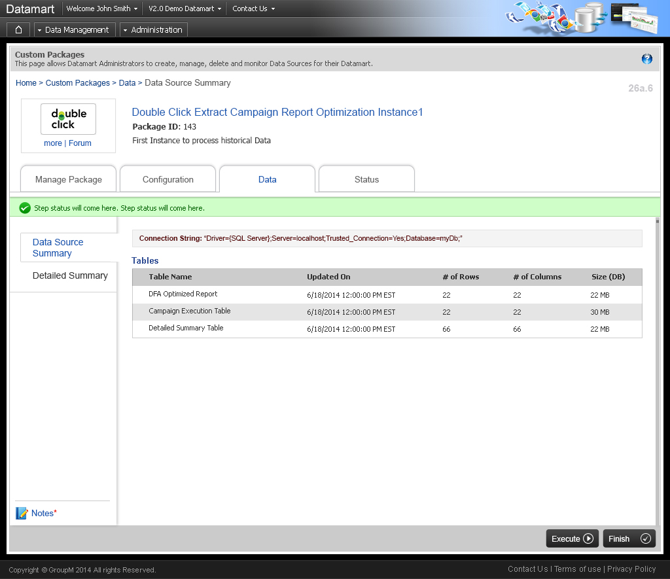
Landing Page

Slide 49
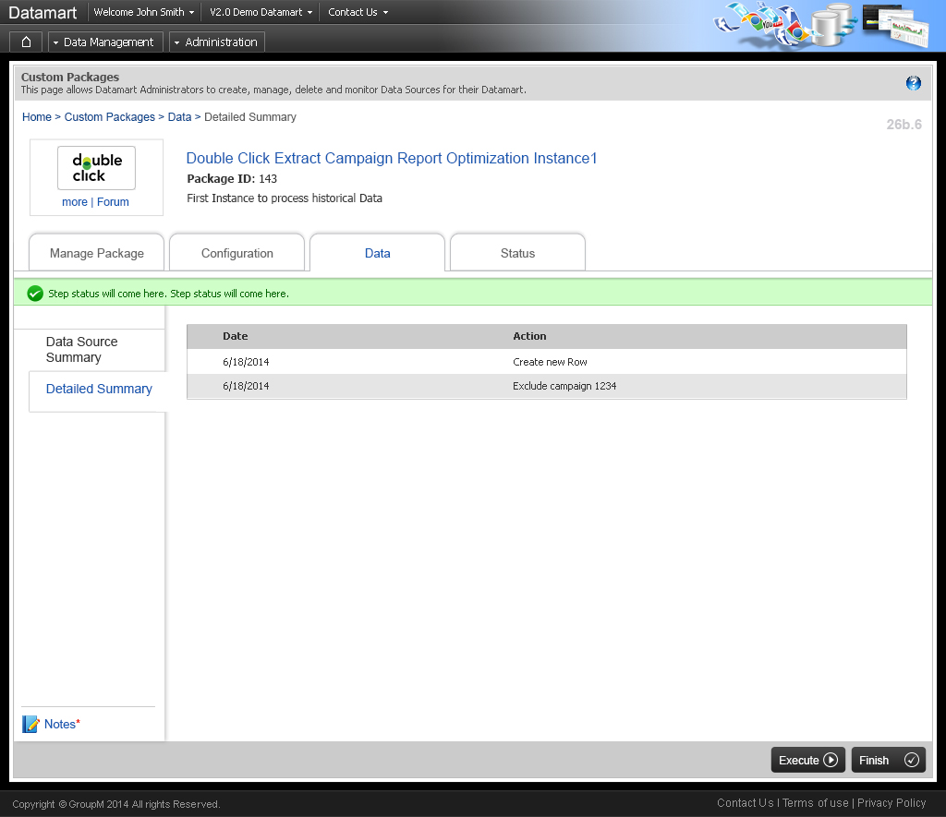
Landing Page

Slide 50
www.cybage.com
Custom Package > Status
Copyright © 2011. Cybage Software Pvt. Ltd. All Rights Reserved. Cybage Confidential.

Slide 51
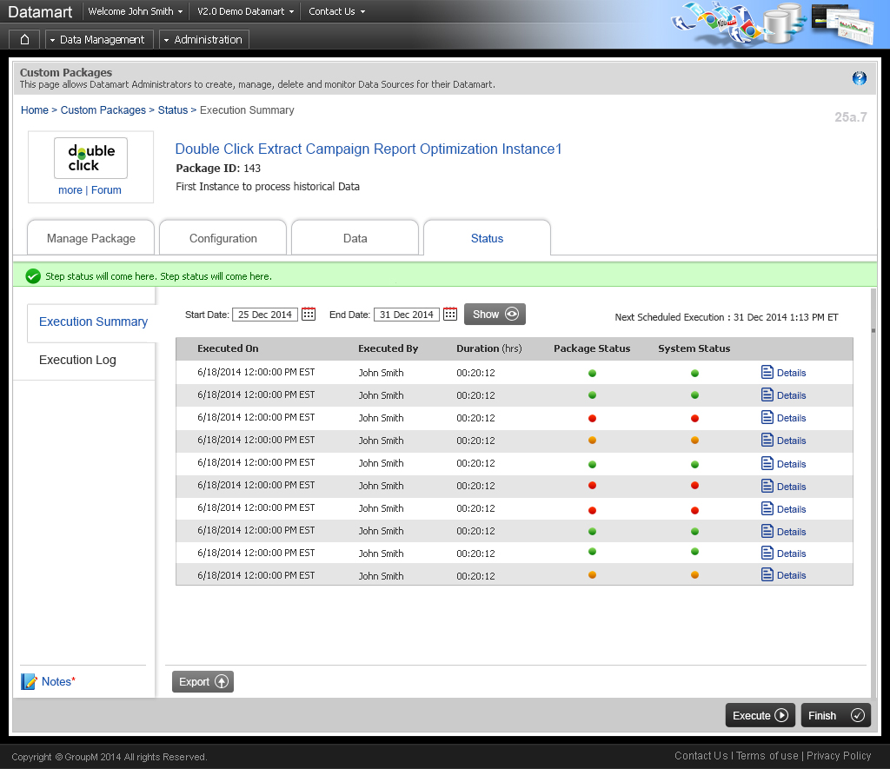
Landing Page

Slide 52
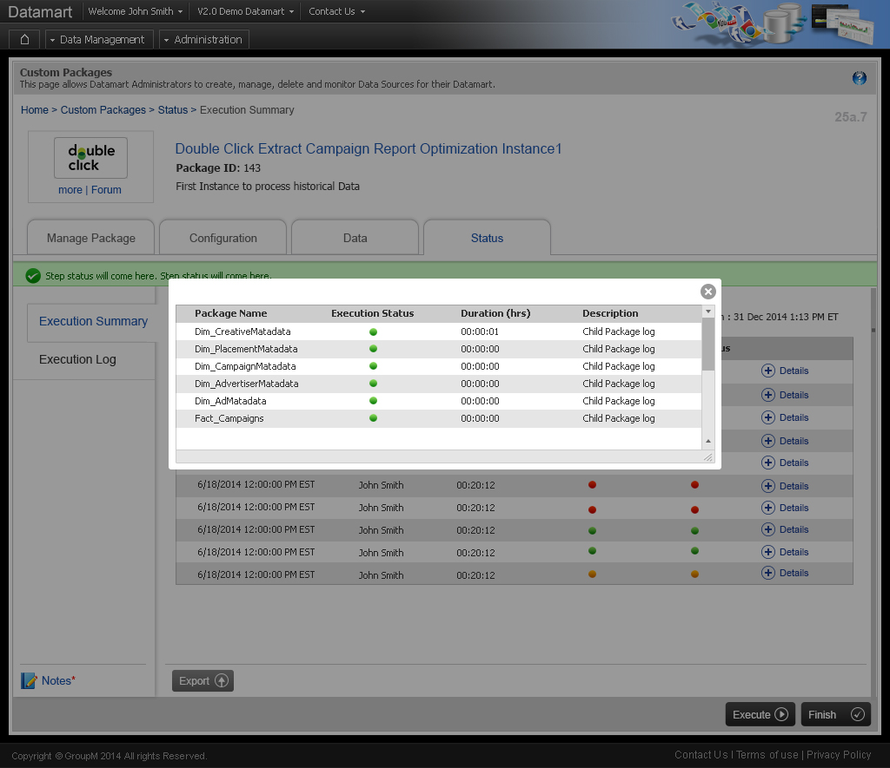
Landing Page

Slide 53
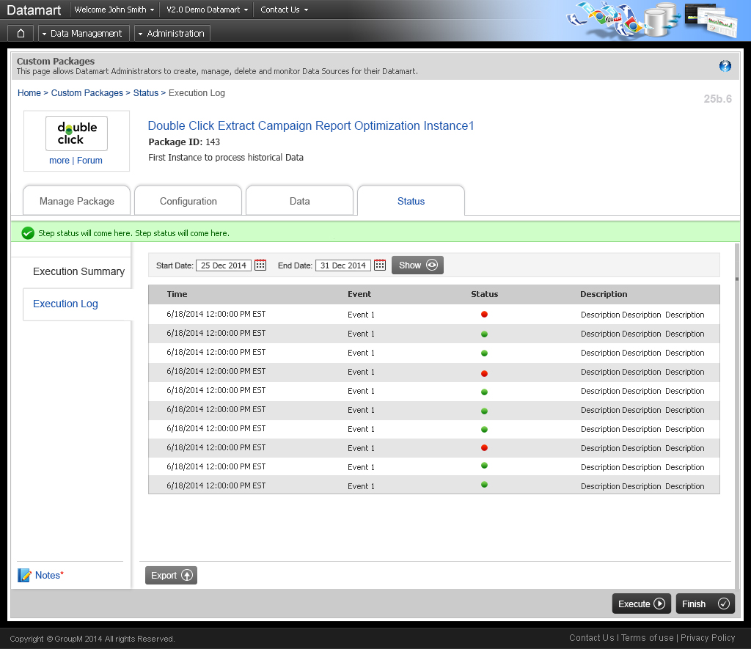
Landing Page

